Slide 1
NYSED Informational Webinar June 29, 2017
Community Schools Grant
(CSG): Aid to Localities
Guidance/Application

Slide 2
Webinar Agenda
Laws and Regulations
Eligibility
District Allocations
Persistently Struggling and Struggling Schools (PSS and SS) Funding
Allowable Uses of Grant Funds
Examples of Operating and Capital Costs
Community Schools Grant Application Checklist
Community School Site Coordinator
Including Feeder Schools
Research and Resources
Application Submission Instructions
Minority and Women-Owned Business Enterprise (M/WBE) Requirements
Questions and Answers
Application Submission and Review Timeline
Office of Innovation and School Reform (OISR) Contact Information

Slide 3
2016-2017 Budget Appropriation Bill (Chapter 53 of the Laws of 2016)
$75,000,000 appropriation:
$50,000,000 for operating costs
$25,000,000 for capital costs
Purpose: to establish Community Schools Grants for eligible school districts with schools designated as either Struggling Schools (SS) or Persistently Struggling Schools (PSS) by the Commissioner (Ed Law §211-f(1)(a) or (b)) throughout the 2016-2017 school year.
Funding: 2017-18 Implementation Period: August 1, 2017 – June 30, 2018 to support 72 SS/PSS within 11 school districts, including the University of Rochester as the EPO for East Upper and East Lower School.
Access to funds: Eligible school districts apply to the New York State Education Department for Community Schools Grants to transform SS and PSS into community hubs to deliver services to students and families.

Slide 4
CR §100.19 Amendment
At its October 2016 meeting, the Board of Regents adopted a proposed amendment to CR §100.19 relating to Community Schools Grants and the definition of community schools in order to implement Education Law §211-f and Chapter 53 of the Laws of 2016.
The amendment requires that all applications for funding include detailed plans and timelines for ensuring substantial parent, teacher, and community engagement in the planning, implementation and operations of the community school.
The Regents item for this amendment is posted at: http://www.regents.nysed.gov/common/regents/files/1016brca6.pdf

Slide 5
Community Schools Grant
Allocations and Use of Grant Funds

Slide 6
Eligibility and District Allocations
Eligible districts are those that have schools designated by the Commissioner as either Struggling or Persistently Struggling (Ed Law §211-f(1)(a) or (b)) throughout the 2016-2017 school year.
The Accountability Designations table lists eligible districts and is posted at: http://www.p12.nysed.gov/oisr/.
Each district is provided an allocation for program and capital expenditures. Approximately 2/3 of the allocation is for program costs; and 1/3 is for capital costs.

Slide 7
Community Schools Grant District Allocations
District | Capital Grant Maximum | Program Grant Maximum | Total
Albany | $ 1,251,967 | $ 2,410,362 | $ 3,662,329
Buffalo | $ 3,915,338 | $ 9,406,698 | $13,322,036
Hempstead | $ 1,852,189 | $ 3,565,945 | $ 5,418,134
Mount Vernon | $ 302,314 | $ 582,033 | $ 884,347
NYC | $ 8,678,074 | $16,707,546 | $25,385,620
Poughkeepsie | $ 470,039 | $ 904,946 | $ 1,374,985
Rochester* | $ 3,803,063 | $ 7,321,883 | $11,124,946
Syracuse | $ 3,376,352 | $ 6,500,354 | $ 9,876,706
Troy | $ 188,324 | $ 362,572 | $ 550,896
Wyandanch | $ 372,273 | $ 716,721 | $ 1,088,994
Yonkers | $ 789,880 | $ 1,520,724 | $ 2,310,604
Grand Total | $24,999,813 | $49,999,784 | $74,999,597
*Note: Within the Rochester School District’s grant, $2,281,182 is allocated to the East Upper and East Lower Schools with $1,501,360 allocated for the Program Grant and $779,822 allocated for the Capital Grant. These schools are under the management of the University of Rochester, operating as the EPO. The Rochester City School District must apportion these funds for use by these schools.

Slide 8
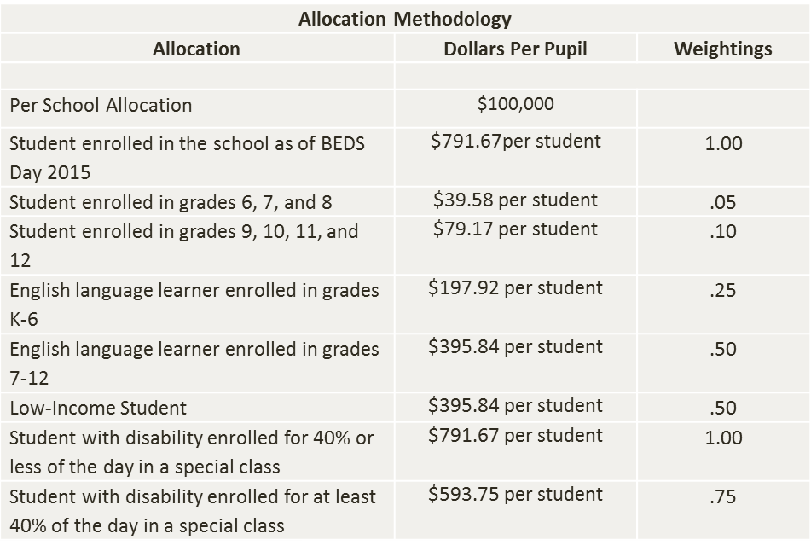
Allocation Methodology
Note: These are duplicated counts, so a low income high school student who is an English language learner would generate $1662.52 ($791.67 + $79.17 + $395.84 + $395.84) towards the district’s allocation.

Slide 9
Apportioning Funding to Persistently Struggling and Struggling Schools
To find the Persistently Struggling and Struggling Schools in your district, reference the Persistently Struggling and Struggling Schools by District table within Attachment A.
To find the total amount of operating (program) and capital grant funds allocated to your district, reference Attachment A, the Community Schools Grant Allocations by District table.
Each district shall decide the amount of funding to apportion to each of its Persistently Struggling and Struggling Schools, subject to the following restrictions:
Each school that was not operating under a State approved closure or phase out plan as of September 2016 and will continue to operate in the 2017-18 school year must be allocated a minimum grant of $100,000, which may be used for program and/or capital costs.
Each school that was operating under a State approved closure or phase out plan as of September 2016 and that will continue operations in the 2017-18 school year must be allocated a minimum grant of $65,815, which may only be used for program costs.
Reference Attachment A for a listing of schools categorized as “exceptions” to these restrictions.
Applicants are required to clearly identify each budget item as either program or capital on the FS-10, and Attachment C. Attachment C and FS-10 information must be aligned.

Slide 10
Allowable Uses of Grant Funds
These funds must be used to support the operating (program) and capital costs associated with the transformation of designated schools into community hubs to deliver co-located or school-linked academic, health, mental health, nutrition, counseling, legal, and/or other services to students and their families.
Community Schools Grant funds shall be used to supplement and not supplant district expenditures and shall only be used for new expenditures on eligible operating and capital costs. Any activities that are permissible pursuant to the CSG that are newly implemented in the 2017-18 school year or were newly implemented on or after September 1, 2016 in accordance with Chapter 53 of the Laws of 2016 and section 100.19(l)(3) of the Commissioner’s regulations, and will continue to be implemented in the 2017-18 school year will be deemed approvable for the 2017-18 school year and will not be considered supplanting.
Prior to September 1, 2016, schools may have begun to implement a community school strategy using other fund sources. Examples include the SIG’s Family and Community School Design pathway, Community Schools Grant Initiative, 21st Century Community Learning Centers Grants, Extended Learning Time Grant Programs, and others. You are required to provide details about all activities and expenses on Attachment C of the application.
Beginning on page 2 of the application, examples of allowable operating and capital activities and expenses are provided. We list a few of those examples on the next slide.

Slide 11
Examples of Operating and Capital Costs
Capital Cost Examples
Operating Cost Examples
Pay for a community school site coordinator
Improve parent engagement
Provide early childhood education programs
Conduct community-wide needs assessment
Create a steering committee
Construct or renovate spaces within SS or PSS buildings to serve as:
Health/guidance suites
Resource/remedial rooms
Adult education spaces
Parent/community rooms
CTE classrooms
Other necessary costs to implement a community school

Slide 12
Community Schools Grant
Application Package

Slide 13
Community Schools Grant Application Checklist
District Cover Page with Original Signature
Part I: Planning, Implementing and Operating a Community School
Part II: Plans to Implement the Community School Strategy
Part III: Budget Requirements
M/WBE Documents

Slide 14
Application Checklist: Part I: Planning, Implementing and Operating a Community School
This section contains several elements required by CR §100.19.
A district provides one comprehensive response in either a narrative or table format. For each of its Receivership schools:
describe substantial parent, teacher and community engagement by describing plans and timelines for holding public meetings, providing written notices and communications, and explaining how those meetings provide meaningful opportunities for input and feedback; and
describe the governance structure of the community schools program, including the roles and responsibilities of the community school site coordinator; and
list activities engaging the local collective bargaining units; and
describe how the district provided community partners and/or the Community Engagement Team the opportunity to review this application and provide feedback.

Slide 15
Part I Continued: Community School Site Coordinator
CR §100.19 requires that the school district designate a full-time staff person to serve as the community school site coordinator at each of its Receivership schools. This coordinator shall assist the school receiver in implementing the CSG.
If circumstances do not justify the assignment of a full-time coordinator (e.g. small school), or one coordinator serves multiple schools (e.g. two small schools close in proximity share a coordinator); the district can apply to the New York State Education Department on behalf of the school for a waiver from this requirement.
The waiver template is posted on the OISR website at: http://www.p12.nysed.gov/oisr/.
In two sections of the CSG application, you are asked to provide details about each school’s community school site coordinator:
Part I: Item 3: Describe the roles and responsibilities of the community school site coordinator. You need to provide this information even if you are not using CSG funds to pay for the community school site coordinator.
Part II: Attachment C: Provide the Community School Site Coordinator’s Name. You will further describe the roles and responsibilities of the community school site coordinator as you describe the activities used to implement a community school strategy.

Slide 16
Application Checklist: Part II: Plans to Implement the Community School Strategy
To complete this section:
Reference the Community Schools Research and Resources section of the application for details about the needs assessment, the community school site coordinator, accessing community school standards, and the stages of development in a community school.
If the school selected Demonstrable Improvement Indicator (DII) #2: Community School Model, reference the YR 2 report you provided to the NYSED Student Support Services (were due 6/1/17). As applicable, use that same information in response to application prompts.
Each district completes one Attachment C for each of its Receivership schools; and submits additional requested documentation for each school. Each school:
must begin its plan to implement a community school strategy with a community-wide needs assessment. The school must either discuss and submit a copy of its community-wide needs assessment conducted within the past three years OR discuss its specific plans and timeline to conduct one. The school should align its efforts to the key steps of the needs assessment process which are outlined in the National Center on Community Schools’ Needs Assessment Toolkit posted at: http://www.p12.nysed.gov/sss/expandedlearningopps/CSGI/home.html; and
must identify and describe its Community School Site Coordinator, Steering Committee, Feeder Schools, and Community School Partner Agencies (and submit a preliminary MOU), and
must describe its specific professional development plan; and
must submit its updated 17-18 school intervention plan highlighting in bold the specific changes resulting from the implementation of the CSG; and
must describe all eight CR §100.19 required components as they align to school’s needs assessment, CSG budget, DIIs, impact on student achievement, implementation timeline, and school intervention plan.

Slide 17
Part II Continued: Community-Wide Needs Assessment
On Attachment C, the district will discuss the status of each school’s community-wide needs assessment, by referencing each step in the National Center for Community Schools (NCCS)’ Needs Assessment Toolkit.
The school does not have to use the templates provided in the Toolkit but must rather ensure that the major components of each step have been addressed.
If such a needs assessment has been conducted at the school within the past three years, the district will reference each step, briefly describe the major findings, and submit a copy with the application.
If one has not been conducted within that timeframe, describe the school’s plan to conduct one, including the amount of the CSG funds to be allocated to each step, and for what specific activities.
Guidance relevant to conducting a community-wide needs assessment is provided on pages 2-3 in the application, and under this section of the application: When Reviewing the Needs Assessment Toolkit.

Slide 18
Part II Continued: Memorandum of Understanding (MOU)
Preliminary MOU:
Applicants must submit a preliminary Memorandum of Understanding (MOU) between local education agencies (LEAs) and community partners. Schools should consider working with established Community School models that have a record of proven success.
This preliminary MOU must minimally establish the roles and responsibilities of each partner; proposed strategies for communication and collaboration; and methods partners will employ to hold one another accountable for performance. The MOU must provide an overview of all partners’ involvement in planning and program implementation.
The preliminary MOU may take the form of a fully signed and executed MOU or a draft MOU that has not been signed by all parties.
Fully-Executed MOU:
Applicants will be required to submit a final, fully signed and executed MOU that provides a detailed description of each partner’s roles and responsibilities. This final MOU may include additional partners that were not identified in the original MOU and must be approved by NYSED prior to the receipt of initial grant funding. If the district submits a preliminary MOU with the application that takes the form of a fully signed and executed MOU, NYSED will be in a better position to approve the MOU sooner than if the district submits a draft MOU without signatures. A final, fully signed and executed MOU needs to be approved no later than September 30, 2017 or NYSED will withhold CSG funds.
MOU Alignment to Attachment C: Question 2:
Information provided in the MOU should align to the response provided in Attachment C, Question 2. That question asks the district to describe how the partners will contribute to the implementation of the community school strategy and how partners will be involved in both shared leadership and in decision-making processes with the school.

Slide 19
Part II Continued: Providing Services to Feeder Schools
Feeder schools do not receive CSG funds; they can receive services from a Receivership school receiving CSG funds.
If the application includes feeder schools as the recipients of services, you will be asked to list them on Part II: Attachment C.
As per CR § 100.19:
Each Receivership school that receives a CSG to deliver co-located or school-linked services shall first provide such services to the students who are enrolled in such school and their families.
If a designated school has additional unused capacity after making such services available to all enrolled students and their families, the school may offer such services to students who attend feeder schools and their families and/or students who are alumni of the school and their families.
The definition of a “feeder school” is on pages 7-8 of the application.

Slide 20
Application Checklist: Part III: Budget
Each district submits one FS-10 and one “Attachment D: District Summary Budget Narrative” addressing each of its Receivership schools.
For every budget item listed on the FS-10, the district must identify the school associated with that item AND whether the item is an operating (program) cost or a capital cost.
The 2017-18 FS-10 budget period is August 1, 2017 - June 30, 2018. Any activities that are permissible pursuant to the CSG that are newly implemented in the 2017-18 school year or began on or after September 1, 2016, and will continue in the 2017-18 school year will be deemed approvable for the 2017-18 school year and will not be considered supplanting.
The Chief Administrative Officer must sign the FS-10.
The Part III: Attachment D: District Summary Budget Narrative must align to the FS-10, and to Part II: Attachment C.

Slide 21
Application Checklist: M/WBE Documents
The M/WBE participation goal for this grant is 30% of each applicant’s total discretionary non-personal service budget.
Complete the M/WBE Submission Checklist provided in the application. It lists every document needed for submission of the M/WBE Document Package.
The M/WBE Document Package is required as part of submitting a complete CSG application.
Email a copy of the CSG application to OISR@nysed.gov, AND mail the original signed M/WBE, plus one copy to OISR, 89 Washington Avenue, 5N EB Mezzanine, Albany, NY 12234.
All M/WBE forms and templates are provided in the application.
For specific questions, contact MWBE@nysed.gov.

Slide 22
Completing the Application: Community Schools Research and Resources
On pages 2 and 3 of the application, you will find details about these resources:
Attachment B summarizes laws and regulations regarding Community Schools staffing;
a link to a summary of the basic tenets of community schools and research data supporting school improvement, child health, parent engagement, and child development;
National Center for Community Schools’ resources:
Needs Assessment Toolkit
The Role of the Community School Site Coordinator/Director
Stages of Development in a Community School; and
Coalition of Community Schools’ resource:
Community Schools Standards.

Slide 23
Community Schools Grant
Submitting the Application

Slide 24
Questions and Answers
Upon receipt of the CSG application, you can begin to submit questions to OISR@nysed.gov with the subject line reading: CSG Application Questions. Upon receipt of each question, OISR will provide responses to the district in a timely manner.
OISR will post a Q and A document at: http://www.p12.nysed.gov/oisr/ no later than July 21, 2017.
As necessary, OISR will continue to update and repost the Q and A document.

Slide 25
Application Submission Instructions
Each district submits one complete application package that addresses each of its Receivership schools within the application.
The Community Schools Grant Submission Checklist and the M/WBE Submission Checklist identify each document that is to be submitted in order for the application package to be considered complete.
The checklist also provides the number of copies of documents needed.
By 5:00 PM on July 28, 2017, email the complete application package to OISR@nysed.gov with the subject line reading: CSG Application.
By that same date and time, mail the required signed, hard copies to OISR, 89 Washington Avenue, 5N EB Mezzanine, Albany, NY 12234.

Slide 26
Application Submission and Review Timeline*
Ongoing basis: Districts submit questions to OISR@nysed.gov.
No later than July 21, 2017: OISR posts Q and A document at: http://www.p12.nysed.gov/oisr/.
By 5:00 PM on July 28, 2017: Districts email a complete application package to OISR@nysed.gov, AND mail one hard copy to OISR.
Beginning July 31, 2017: NYSED staff review applications.
August 1, 2017: 2017-18 Implementation period begins.
*This timeline is tentative and subject to change.

Slide 27
Reporting Requirements
All Persistently Struggling or Struggling Schools, regardless of the plan implemented or funding received, are required by Education Law 211-f to provide a quarterly report to the board of education, the Commissioner and the Board of Regents.
CR §100.19 requires that Community School Grant awardees submit quarterly written reports to the Commissioner containing specific information about the progress of the planning, implementation, and operations of the Community Schools Grant as well as other requirements, including holding public meetings and providing written notices and communications.
Following approval of CSG applications, OISR will provide details about the submission of quarterly reports. OISR is considering revising its existing Receivership quarterly report template to include a section specific to the Community Schools Grant. The template will be mailed to Superintendents and posted at: http://www.p12.nysed.gov/oisr/.

Slide 28
Thank You for Your Participation! Ira Schwartz, Assistant Commissioner, Office of Accountability
Office of Innovation and School Reform staff:
LoriAnn Curtin
Tracey Johnson
Barbara Moscinski
Antonio Parente
Sonia Sra
OISR@nysed.gov; (518) 473-8852; http://www.p12.nysed.gov/oisr/

